Slide 1
FYP Demonstration: Universal Adversarial Attacks on Graphs
16/04/2021
Liao Chang

Slide 2
Agenda
Brief Introduction
Problem trying to solve
Taxonomy
Proposed approach
What I’ve done
Learning takeaways
Achievement

Slide 3
Brief Introduction
Taxonomy of graph adversarial attacks
Evasion / Poisoning
Targeted / Untargeted
Topology / Node feature
Universal
White-box / Gray-box / Black-box
Problem trying to solve:
Widely used GNNs
Vulnerable to adversarial attacks
Robustness under certain scenarios unknown

Slide 4
Brief Introduction
Propose approach
For gray-box scenario (actual training data unknown):
Propose a surrogate data generation algorithm
Inspired by feature visualization methods in CV
Following adversarial attacks all performed on this set of surrogate data
For universal adversarial attack:
Adapt a universal adversarial attack algorithm in NLP
Modify it with some help from graph theory to select anchor point

Slide 5
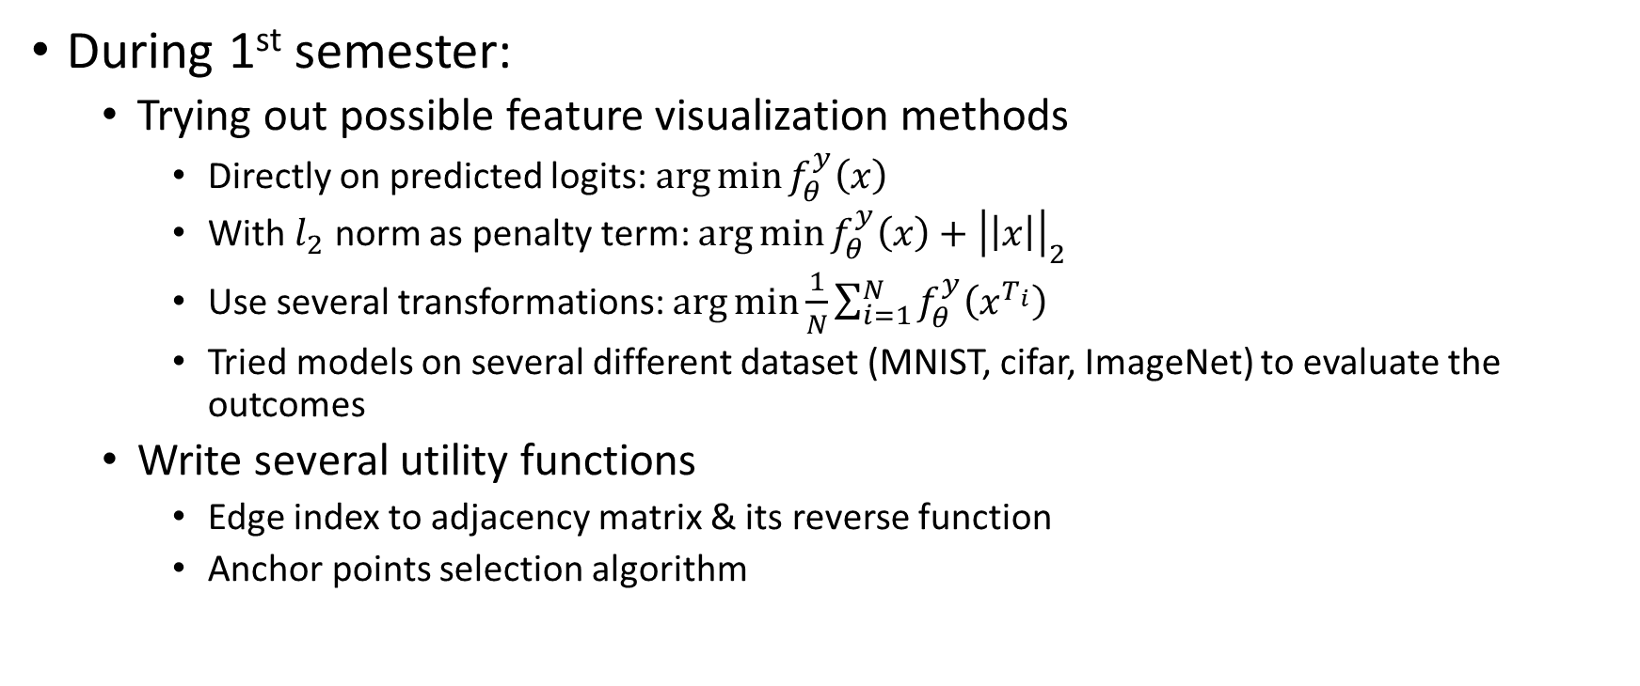
What I’ve done
During 1st semester:
Trying out possible feature visualization methods
Directly on predicted logits: $\arg{\min{f_{θ}^{y}\left(x\right)}}$
With $l_{2}$ norm as penalty term: $\arg{\min{f_{θ}^{y}\left(x\right)+{\left|\left|x\right|\right|}_{2}}}$
Use several transformations: $\arg{\min{\frac{1}{N}\sum_{i=1}^{N}{f_{θ}^{y}\left(x^{T_{i}}\right)}}}$
Tried models on several different dataset (MNIST, cifar, ImageNet) to evaluate the outcomes
Write several utility functions
Edge index to adjacency matrix & its reverse function
Anchor points selection algorithm

Slide 6
What I’ve done
During the 2nd semester:
Migrate surrogate data generation on images to graphs
Randomly initialized adjacency matrix then update node features?
Weighted graphs then update edge attributes?
Migrate universal adversarial attack on texts to graphs
Node embedding via difference of graph embeddings?
Node feature as node embedding?
Highest degree as anchor point?
Lowest degree as anchor point?
Other measurements except node degree?

Slide 7
Learning takeaways
Research-wise:
the methodology & implementation of above-mentioned algorithms
Read lots of papers related to adversarial machine learning
GCNs, adversarial attacks, node centrality measures
Engineering-wise:
Use of pytorch, torch-geometric, network X
Hands on several sota models (as our victim model)

Slide 8
Achievements
First graph-level GUAA algorithm
First gray-box GUAA algorithm with graph feature visualization method
Lower down the performance of a sota-model to a random-guessing level

Slide 9
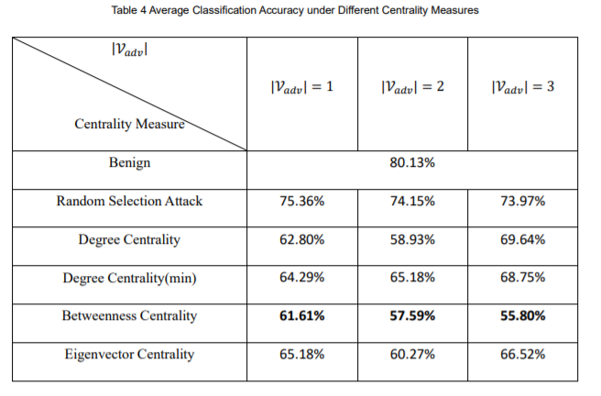
Results

